Slide 1

MINI PROJECT- SMART HOME APPLICATIONS NAME – MAYANK RAI UNIVERSITY ROLL NO – 2019682 Under the Mentorship of DR . PRIYA MATTA
Department of Computer Science and Engineering Graphic Era (Deemed to be University) Dehradun, Uttarakhand
January 2023

Slide 2
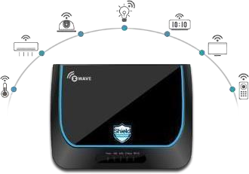
INTRODUCTION In the following of my Mini Project I have described my ideas on the topic ‘SMART HOME APPLICATIONS’ What is smart home applications ? We already know that the Home Automation is an exciting way to interact with our home environment and we can attain higher level of relaxation and convenience with the help of IOT . We can keep an eye on lots of product who follow IOT principle and make our work easier ex- SMART WATCHES , SMART DOOR LOCKER , SMART SPEAKERS , SMART CAMERAS , SMART LED LIGHTS .
Features
Smart Energy Consumption
Security Systems
Temperature control
Face Recognition
Home Automation

Slide 3
PROBLEM STATEMENT ------------------------------------------------------------------------------ First of all i want to tell you that i made my mini project on the topic SMART HOME APPLICATIONS in which I have described how we can manage our home appliances with the help of our mobile phones with the help of Bluetooth and WIFI connectivity so that we can control our devices freely from anywhere. PROBLEM FACED BY PEOPLES ---------------------------------------------- Nowadays the life become so busy that we are not able to do our official work properly because of these household work we have to manage with our work . Day by day it’s going to be very tough task to manage our official work with these small household works. Problems are faced by very old age person and small child also because the both were also not able to do work as both ages require some help to do their work due to our busy life we are not able to fulfil their basic needs . SOLUTION ARRIVES -------------------------------------------------- Solution is SMART HOME APPLIACTIONS . These smart home applications makes the life easier , comfortable , convienence , relaxable , advanced . Home automation is constructing automation for a domestic, mentioned as a sensible home or smart house. In the IOT home automation ecosystem, you can control your devices like light, fan, TV, etc. → A domestic automation system can monitor and/or manage home attributes adore lighting, climate, enjoyment systems, and appliances. It is very helpful to control your home devices. → It’s going to in addition incorporates domestic security such as access management and alarm systems. Once it coupled with the internet, domestic gadgets are a very important constituent of the Internet of Things. → A domestic automation system usually connects controlled devices to a central hub or gateway. → The program for control of the system makes use of both wall-mounted terminals, tablet or desktop computers, a smartphone application, or an online interface that may even be approachable off-site through the Internet.
SOME PLENTY INTRODUCTION OF MY PROJECT
----------------------------------------------------------------------------
My mini project is based on SMART HOME APPLICATIONS USING ARDUINO (SET)
My project is based on both HARDWARE and SOFTWARE
In hardware it requires various components like – ARDUINO , BLUETOOTH MODULE HC-05 , RELAY MODULE , WIRES , BUBLBS , LAPTOP , USB CABLE etc
In software it requires ARDUINO IDE software for coding which have to put in our Arduino . This software mainly follow c , C ++ , JAVA languages etc .
This Arduino is filled with code with the help of laptop
This work is complete with the help of mobile application with the help of bluetooth connectivity with Bluetooth module HC -05

Slide 4


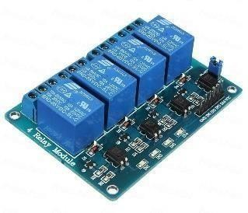
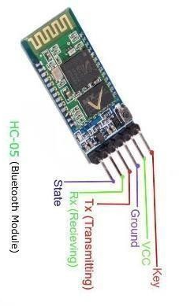
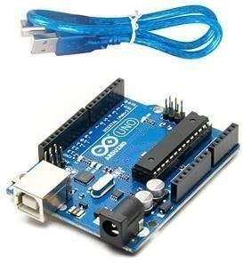
Chapter 3
METHODOLOGY
OVERVIEW
First of all I want to give the overview what I have done in my mini project named – SMART HOME APPLICATIONS . I have completed my mini project by operating smart home appliances using ARDUINO UNO BOARD , BLUETOOTH HC – 05 , 4 CHANNEL RELAY BOARD , MALE
AND FEMALE JUMPER WIRES , LAPTOP , CODE (programmed in c , c ++ language) , USB Cable wire , BULB , EXTENSION BOARD etc . I have made the circuit in such a way that the circuit has no error and no error in the programming code . I have made the connection which I am going to show below in my methodology and i also used ARDUINO IDE software to program my code and put it in my Bluetooth module and after that I connected that Bluetooth with my mobile phone and download a certain application which allows to connect my mobile phone with Bluetooth module.
After that with the help of that application I make my home appliances connect with my mobile phone and worked smartly in such a way that when I on the switch in the mobile phone the appliance which is connected to phone will become on and vice-versa
FLOWCHART OF PROCESS
Extension Board
Bulb
4 Channel Relay Board
Bluetooth Hc-05
AEDUINO UNO
13

Slide 5
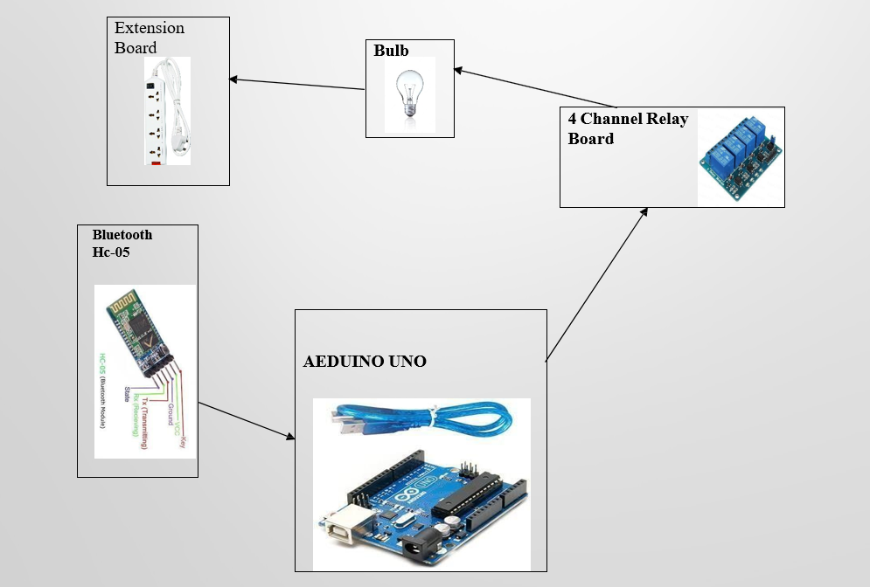
METHODOLOGY OVERVIEW First of all I want to give the overview what I have done in my mini project named – SMART HOME APPLICATIONS . I have completed my mini project by operating smart home appliances using ARDUINO UNO BOARD , BLUETOOTH HC – 05 , 4 CHANNEL RELAY BOARD , MALE AND FEMALE JUMPER WIRES , LAPTOP , CODE (programmed in c , c ++ language) , USB Cable wire , BULB , EXTENSION BOARD etc . I have made the circuit in such a way that the circuit has no error and no error in the programming code . I have made the connection which I am going to show below in my methodology and i also used ARDUINO IDE software to program my code and put it in my Bluetooth module and after that I connected that Bluetooth with my mobile phone and download a certain application which allows to connect my mobile phone with Bluetooth module. After that with the help of that application I make my home appliances connect with my mobile phone and worked smartly in such a way that when I on the switch in the mobile phone the appliance which is connected to phone will become on and vice-versa
FLOWCHART OF PROCESS

Slide 6
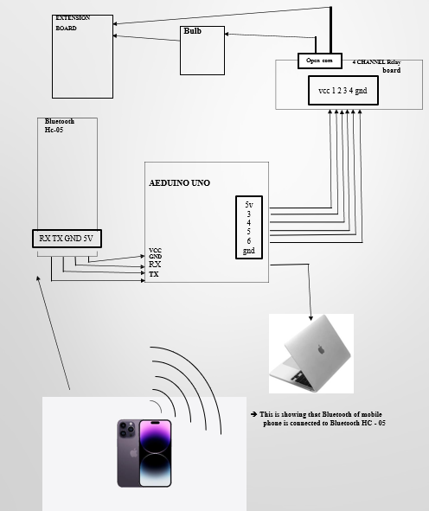
CIRCUIT DIAGRAM OF PROCESS

Slide 7
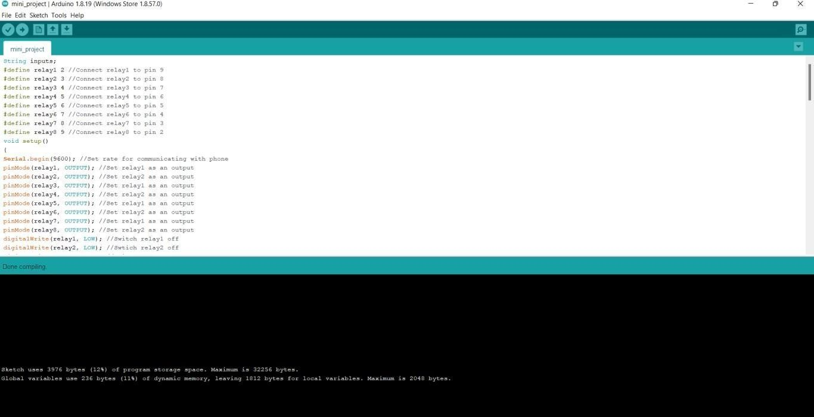
ARDUINO IDE SOFTWARE FOR PROGRAMMING SHOWING THE SUCCESSFULLY COMPILATION OF CODE
STEPS
STEP 1 – First I download ARDUINO IDE software in my laptop and run my code and then I connect my Arduino uno board with my laptop and upload that code inside it.
STEP – 2 now I take 4 wires and connect the RX , TX , GND , 5V of Bluetooth HC-05 with TX , RX
, GND , Vin of ARDUINO UNO board.
STEP – 3 after that I take 6 wires and connect VCC , GND , In1 , In2 , In3, In4 of RELAY board to 5v , GND , 3 , 4, 5 , 6 column of the Arduino board.
STEP – 4 Connect the Arduino to power supply.
STEP – 5 Now we make the connection of the bulb by applying the wire on the OPEN SOURCE of the relay and connect one wire of bulb to the COMMON SOURCE of the RELAY board.
STEP – 6 After that I connect the one wire from source part of the relay an done wire from the bulb to the extension board for the power supply.
STEP – 7 Now i downloaded the android application in my mobile phone connect my Bluetooth hc - 05 .
STEP -8 You can see that your appliance start working with your phone .
STEP – 9 You can control your home appliances with your mobile by switching onn/off.
STEP – 10 In this way I made my mini project – SMART HOME APPLICATIONS .

Slide 8
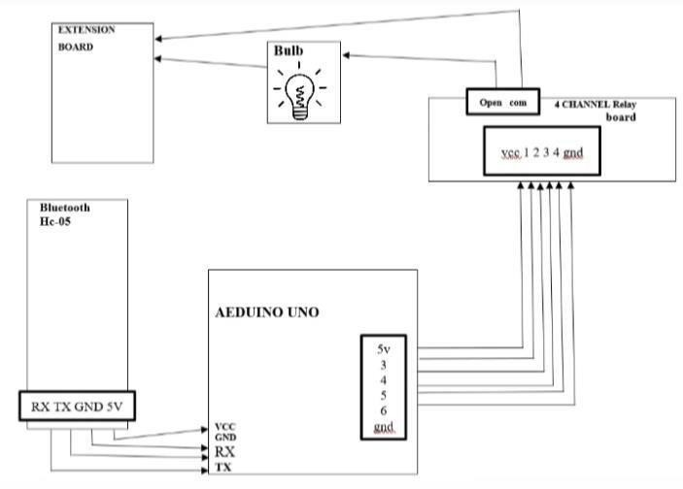
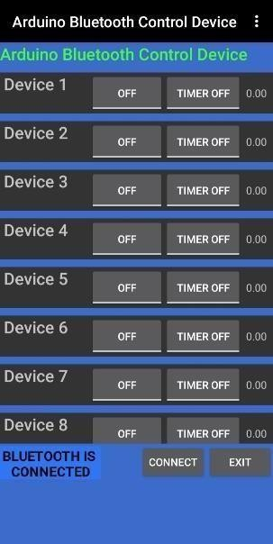
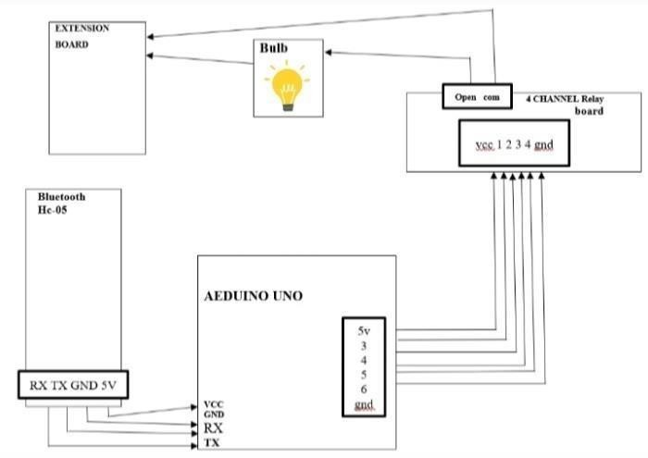
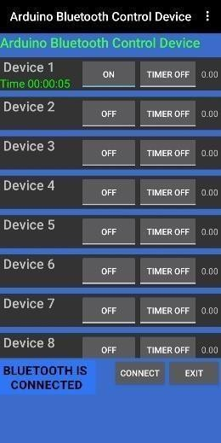
RESULT AND DISCUSSION RESULT OVERVIEW In the Result we clearly see that the when i successfully connect the circuit with help of diagram I mentioned in my methodology then our home appliances started working smartly with the help of our mobile phone and we can operate our home appliances very smoothly and conveniently DISPLAY OF RESULT Now I am going to show you RESULTS Displaying the RESULT when the SWITCH IS OFF Clearly shows when the switch is OFF in the application BULB does not glow
Displaying the RESULT when the SWITCH IS ONN
Clearly shows when the switch is ONN in the application BULB glows

Slide 9
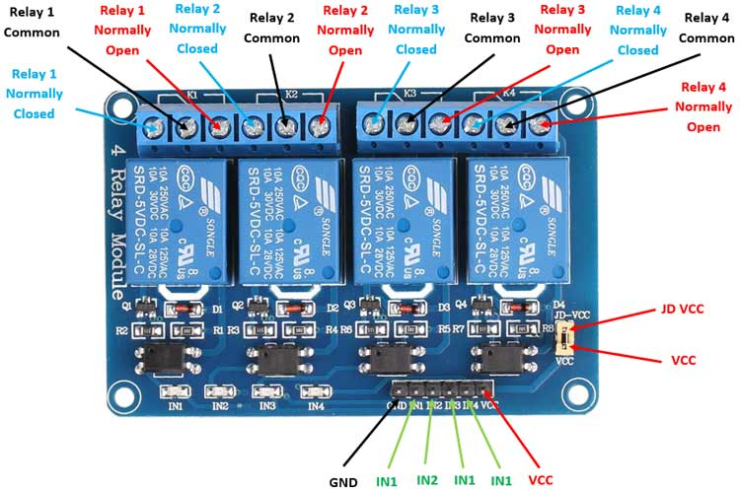
DESCRIPTION OF CODE
-------------------------------------------------------------------------------------------------------
#include <EEPROM.h>
#include <SoftwareSerial.h>
String inputs;
#define relay1 2 //Connect relay1 to pin 6
#define relay2 3 //Connect relay2 to pin 5
#define relay3 4 //Connect relay3 to pin 4
#define relay4 5 //Connect relay4 to pin 3
void setup()
{
Serial.begin(9600); //Set rate for communicating with phone
pinMode(relay1, OUTPUT);
pinMode(relay2, OUTPUT);
pinMode(relay3, OUTPUT);
pinMode(relay4, OUTPUT);
digitalWrite(relay1, LOW);
digitalWrite(relay2, LOW);
digitalWrite(relay3, LOW);
digitalWrite(relay4, LOW);
}
void loop()
{
while(Serial.available()) //Check if there are available bytes to read
{
delay(10); //Delay to make it stable
char c = Serial.read(); //Conduct a serial read
if (c == '#'){
break; //Stop the loop once # is detected after a word
}
inputs += c; //Means inputs = inputs + c
}
if (inputs.length() >0)
{
Serial.println(inputs);
if(inputs == "A") // suppose 1st is BULB in the application and if ONN button is press then 'a' command goes to arduino and then BULB is onn otherwise if push OFF button the 'A' command goes to arduino and BULB is off
{
digitalWrite(relay1, LOW);
}
else if(inputs == "a")
{
digitalWrite(relay1, HIGH);
}
else if(inputs == "B") // suppose 2nd is LED in the application and if ONN button is press then 'b' command goes to arduino and then LED is onn otherwise if push OFF button the 'B' command goes to arduino and LED is off
{
digitalWrite(relay2, LOW);
}
else if(inputs == "b")
{
digitalWrite(relay2, HIGH);
}
else if(inputs == "C") // suppose 3rd is FAN in the application and if ONN button is press then 'c' command goes to arduino and then FAN is onn otherwise if push OFF button the 'C' command goes to arduino and FAN is off
{
digitalWrite(relay3, LOW);
}
else if(inputs == "c")
{
Relay 2
Relay 1
Relay 3
Relay 4

Slide 10
else if(inputs == "D")
{
digitalWrite(relay4, LOW); // suppose 4th is AC in the application and if ONN button is press then 'd' command goes to arduino and then AC is onn otherwise if push OFF button the 'D command goes to arduino and AC is off
}
else if(inputs == "d")
{
digitalWrite(relay4, HIGH);
}
inputs="";
}
}
DISCUSSION
---------------------
LIBRIARY USED – EEPROM
It stands for Electronic Erasable Programmable Read Only Memory . The EEPROM library allows us to read the bytes stored in the memory when the power of the board is off.
SOFTWARE SERIAL
The Software Serial Library permits serial communication over digital Input/output pins. The 0 and 1 pins are inbuilt on Arduino for the serial interface.
VOID SETUP()
It contains an initial part of the code to be executed. The pin modes, libraries, variables, etc., are initialized in the setup section. It is executed only once during the uploading of the program and after reset or power up of the Arduino board.
SERIAL.BEGIN
The serial.begin( ) sets the baud rate for serial data communication. The baud rate signifies the data rate in bits per second.
Default rate – 9600 bps.
PinMode
The specific pin number is set as the INPUT or OUTPUT in the pinMode () function.
The Syntax is: pinMode (pin, mode)
DIGITAL WRITE
The digitalWrite ( ) function is used to set the value of a pin as HIGH or LOW.
VOID LOOP
The loop contains statements that are executed repeatedly. The section of code inside the curly brackets is repeated depending on the value of variables.
SERIAL AVAILABLE
The Serial.available( ) function in Arduino gets the stored bytes from the serial port that are available for reading. It is the data, which is already stored and arrived in the serial buffer. The serial buffer in Arduino holds the 64 bytes.
DELAY() FUNCTION
The delay( ) function pauses the program or task for a specified duration of time. The time is specified inside the open and closed parentheses in milliseconds.
Where,
1 second = 1000 milliseconds
SERIAL.READ()
The Serial.read( ) in Arduino reads the incoming serial data in the Arduino.
SERIAL.PRINTLN
The Serial.println ( ) means print line, which sends the string followed by the carriage return ('\r' or ASCII 13) and newline ('\n' or ASCII 10) characters.

Slide 11
CONCLUSION AND FUTURE WORK In conclusion at last I want to tell you that the SMART HOME APPLICATIONS are the future of upcoming generation . Wireless control is the most significant basic needs for all the people. Our Home automation will be helpful for disabled and Elderly people to perform ON and OFF operation automatically with the help of the mobile phones. The people will be able to interact with the system. It also is an important aspect in the present world where people are so busy, this would help them in easing the basic functionality of their life. IoT technology has great impact in everyone’s everyday life. This survey describes various methodologies used in home automation system to control and access the home appliances remotely through Internet services anywhere anytime . This ARTIFICIAL INTELLIGENCE is becoming future. Main purpose of home automation system is to provide ease to people to control different home appliances with the help of the android application present in their mobile phones and to save electricity, time and money.
At last of my topic I want to tell you that SMART HOME APPLICATIONS is to going to become our future and most important thing in our daily life .

